Slide 1
Chapter Eighteen
Working with Mac OS and Linux

Slide 2


220-902 Objective Covered
2.1 Identify common features and functionality of the Mac OS and Linux operating systems.

Slide 3
Best Practices
Scheduled backups
Scheduled disk maintenance
System updates/App store
Patch management
Driver/firmware updates
Antivirus/Antimalware updates

Slide 4
Storage Mechanisms
Working copies - sometimes referred to as shadow copies, are partial or full backups that are kept at the computer center for immediate recovery purposes.
Most likely the most recent backups that have been made.

Slide 5
Storage Mechanisms
Journaled file system (JFS)
Includes a log file of all changes and transactions that have occurred within a set period of time(such as the last few hours).
If a crash occurs, the OS can check the log files to see which transactions have been committed and which ones have not.
System is restored to pre- crash state

Slide 6
Storage Mechanisms
Onsite storage usually refers to a location on the site of the computer center that is used to store information locally
Tapes, Cartridges kept in fireproof containers

Slide 7
Storage Mechanisms
Offsite Storage
refers to a location away from the computer center where paper copies and backup media are kept
Notes:
Determining which storage mechanism to use should be based on the needs of the organization,
the availability of storage facilities, and the budget available.

Slide 8
Scheduled Maintenance
The file systems used on Mac OS and Linux rarely, if ever, need to be defragmented
Both ext3 and ext4 have on-the-fly defragmentation methods and implement file allocation strategies different than their traditional Windows counterparts.
Defrag is not a maintenance routine in OS and Linux
Notes:
Disk Defragmenter, which has existed in almost all versions of Windows, and is able to take file data that has become spread out over the disk and put it all in the same location, known as defragmenting.
This decreases the time it takes to retrieve files and it should be done with every OS.

Slide 9
System Updates/App Store
Keep the operating system current and updated
App Store represents a location where you can also find updates

Slide 10
Patch Management
Updates fix many things while Patches fix a few
Multiple patches are rolled into update
Advanced Package Tool can be useful in getting the patches from a repository site and downloading them for installation.
Command – (apt-get)

Slide 11
Tools
Backup/Time Machine
Restore/Snapshot
Image Recovery
Disk Maintenance Utilities
  du ( shows disk space in use)
  , df (shows free disk space
  , and fsck (checks and repairs disk)
Shell/Terminal
Bash (Bourne Again Shell)
  OpenSSH (OpenShell)
Screen Sharing
Force Quit
Notes:
Time Machine is an application from Apple that can be used to make backups of various types (incremental, full, and so forth
Snapshots are archives of key files and settings as they exist at a moment in time – subset of an image
Image recovery – larger than snapshots, includes all files in the system at a moment in time
Terminal The command-line interface in Linux is usually reached through a terminal session.
Shell—the interpreter between the user and operating system within Terminal
Screen sharing This feature is built into Mac OS X, and it allows you to share your screen with others.
Force Quit There are a few occasions where an application can become a runaway. When
that happens with the Mac OS, you can use Force Quit to force it to close

Slide 12
Mac OS X Features
Multiple Desktops/Mission Controls (switch between apps/desktops)
Key Chain (password management system)
Spot Light (search for documents, images, apps …)
iCloud (small amount free, but anything beyond that requires payment)
Gestures
Finder (browse through folders and find files, disks, apps …)
Remote Disk (access files on a disc in another machine)
Dock (set of icons)
Boot Camp (choose OS as you boot)
Notes:
Mission Control - all open windows and spaces are shown—grouped by app— and you can choose between them
Keychain - It allows you to store passwords for websites, mail servers, Wi-Fi, and so forth
Gestures With Apple products, it is possible to scroll, tap, pinch, and swipe to interact with the Mac or other product in a way that is intended to be natural and intuitive.
Finder is to OS X what Windows Explorer is to Windows 7.
Remote disc – (disc with a c), this Mac OS X feature lets you access files on a CD or DVD installed in one machine on a remote machine

Slide 13
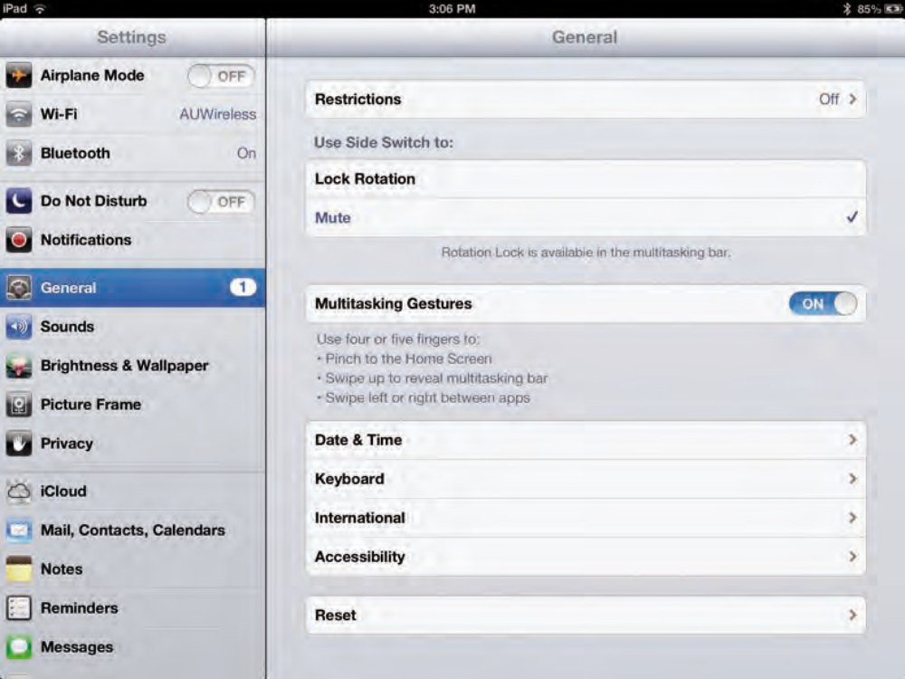
Gestures - iPad

Slide 14
Shell Syntax
command [option1] [option2] ... [optionN]
Blank space after command and between options
If an option contains spaces, you put that option inside quotation marks
grep "Emmett Dulaney" etc/passwd

Slide 15
Shell Syntax (contd..)
If a command is too long to fit on a single line, you can press the backslash key (\) followed by Enter
e.g.
cat \
/etc/passwd

Slide 16
Shell Syntax (contd..)
concatenate (string together) several shorter commands on a single line by separating the commands with semicolons (;).
e.g.
cd; ls -l; pwd

Slide 17
Essential Linux Commands
Command Name | Action
cd | Change the current directory.
chmod | Change file permissions
chown | Change the file owner and group
cp | Copy files
ls | Display the contents of a directory
mkdir | Create a Directory
mv | Rename and move a file
rm | Delete file
pwd | Display the current directory
Notes:
Linux supports the concept of a current directory, which is the directory on which all file and directory commands operate. Current directory is the Home directory when you just log in.
Pwd – shows the current directory you are in
Cd – changes the directory – e.g. To change the current directory
to /usr/lib, type the following:
cd /usr/lib
If CUPS is in the /usr/lib directory you can simply change to it by typing:
cd cups
absolute pathname = /usr/lib/cups
relative pathname = cups
(~) – Tilde refers to your Home directory. Therefore cd ~ takes you to Home. Cd ~Tom takes you to the user, Tom’s home directory
A single dot (.) indicates the current directory, whereas two dots (..) indicate the parent directory
cd .. Takes you one level up a directory

Slide 18
Directory List
ls – contents of directory
ls –F – directory names appear with (/) appended to them, filenames appear as is, (@) indicates that file is a link-refers to another file/shortcut, (*) refers to an executable file
Notes:
A link is like a shortcut in Windows

Slide 19
Directory List
ls –l Directory listing in columns with more info
leftmost column shows the file’s permission settings (rwx)
9 letters. Hyphen (-) indicates no permission for a specific operation on the file
ls –a lists files whose names begin with a period
Notes:
Understanding the 9 letters
Leftmost group Controls the read, write, and execute permission of the file’s owner . Rwx in the first group means owner can read, write and execute. Rw- means owner can read, write but not execute
Middle group Controls the read, write, and execute permission of any user belonging to that file’s group
Rightmost group Controls the read, write, and execute permission of all other users (collectively thought of as the world)
ls command is that it doesn’t list any file whose name begins with a period – use (ls –a)

Slide 20
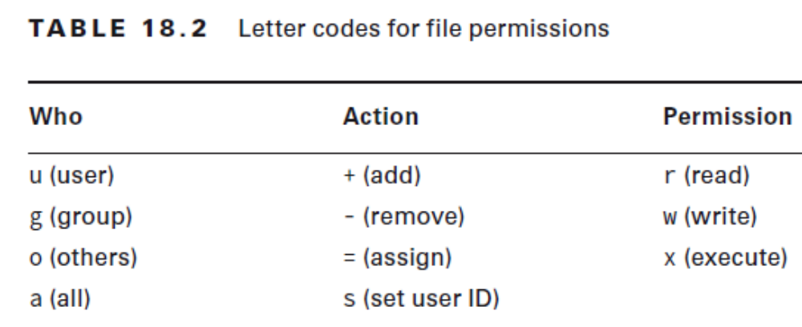
Changing Permissions and Ownership
Use the chmod command to change the permission settings of a file or a directory.
Use the chown command to change the ownership of a file or a directory.
Notes:
chmod a+r *.
Gives everyone read access to all of the files in a directory
chmod a+x filename
Permits everyone to execute one specific file
chown lp.sys cups
Changes the ownership of the cups directory to user ID lp and group ID sys

Slide 21
Linux Utilities: Processing and Managing Files
Command Name | Action
dd | Copy blocks of data from one file to another (used to copy data from devices).
grep | Search for regular expressions in a text file.
apt-get | Download files from a repository site.
ps | Display a list of currently running processes.
shutdown | Shut down Linux.
vi | Start the visual file editor.
Kill | Stop a process
Notes:
ps ax shows you the current set of processes
ps ax -cols 132 (the -cols 132 option is used to ensure that you see each command in its entirety
Results:
PID TTY STAT TIME COMMAND
1 ? S 0:01 init [5]
1 = Process Identifier (PID), It is issued sequentially by the Kernel
Init = Command used to start the process (init is referred to as the mother of all processes)
? = TTY column shows the terminal, if any, associated with the process
S = STAT/Status of the process. S is sleeping, and R means that it’s running
0:01 = CPU time used by the process

Slide 22
Linux Utilities: Managing Users
Command Name | Action
passwd | Change the password.
su | Start a new shell as another user (the other user is assumed to be root when the command is invoked without any argument).
sudo | Allows you to run a command as another user (usually the root user)
Notes:
(su –) is the same as (su)
exit to return to your normal username
Alternatively you can type sudo followed by the command that you want to run as root
Type man sudoers to read more about the /etc/sudoers file

Slide 23
Linux Utilities: Networking
Command Name | Action
ifconfig | View and change information related to networking configuration.
iwconfig | Similar to ifconfig, but used for wireless configuration
Notes:
ifconfig –help
Gets information about the usage of the ifconfig command
iwconfig
you can view such important information as the link quality, AP MAC address, data rate, and encryption keys,

